Slide 1
Wastewater
Aug 2022

Slide 2
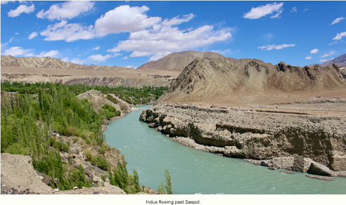
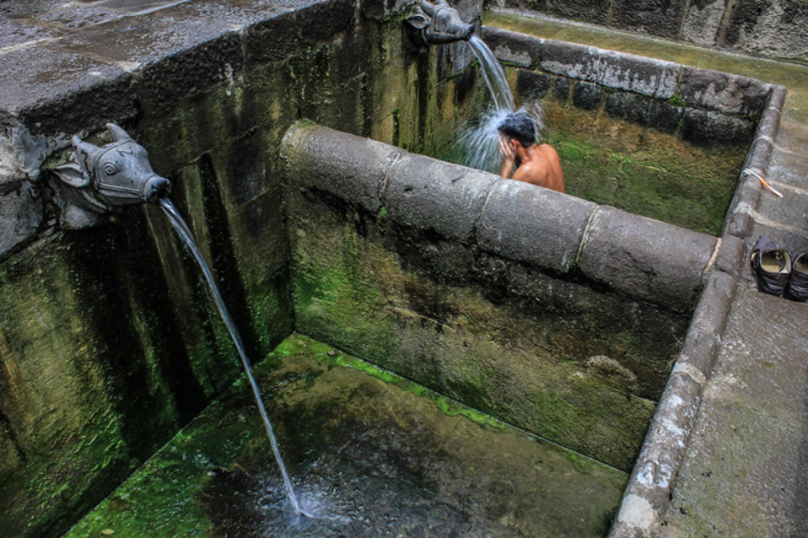
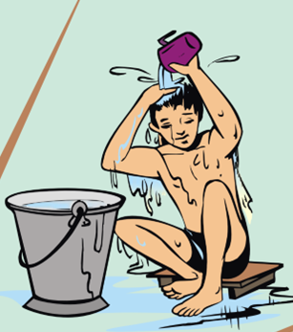
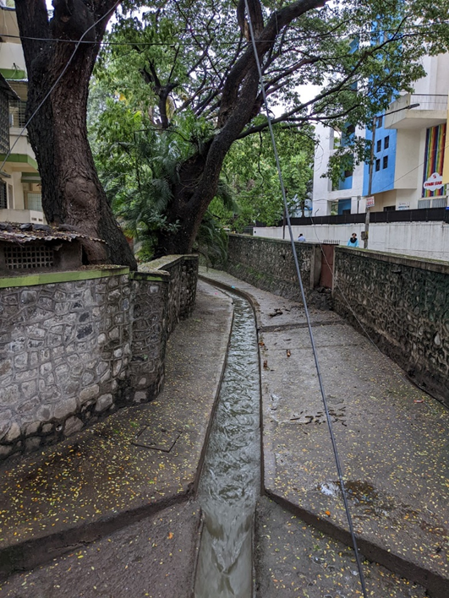
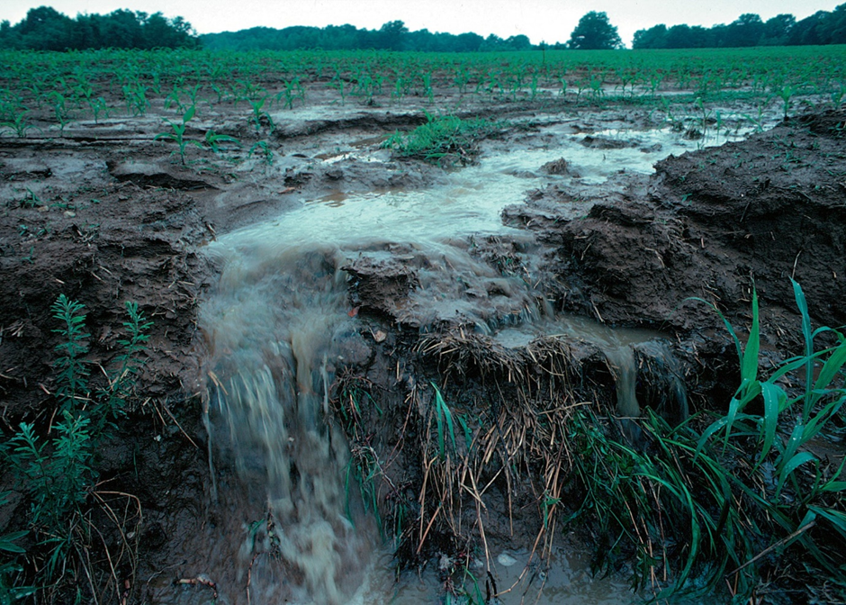
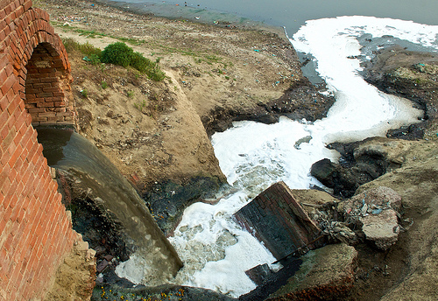
Are these wastewater?
https://www.livingwatersmuseum.org/two-banks-of-a-river-the-indus-in-ladakh
https://www.livingwatersmuseum.org/mutha-river-and-ghats-of-pune
CEE
https://gangaaction.org/actions/issues/industrial-waste-management/
CEE
Lynn Betts https://commons.wikimedia.org/w/index.php?curid=6303766

Slide 3
What does wastewater contain?
List on blackboard

Slide 4
Match the following
Activity | Materials in the used water
1. Bath and toilet | A. Detergents
2. Runoff from fields | B. Food scraps and dish washing soap
3. Washing kitchen utensils | C. Fertilizers and pesticides
4. Washing clothes | D. Body wastes and soap
Wastewater may contain oil, food waste, body wastes, detergents and cleaning agents, pharma products, industrial chemicals, agri-chemicals, trash/ debris, silt, etc

Slide 5
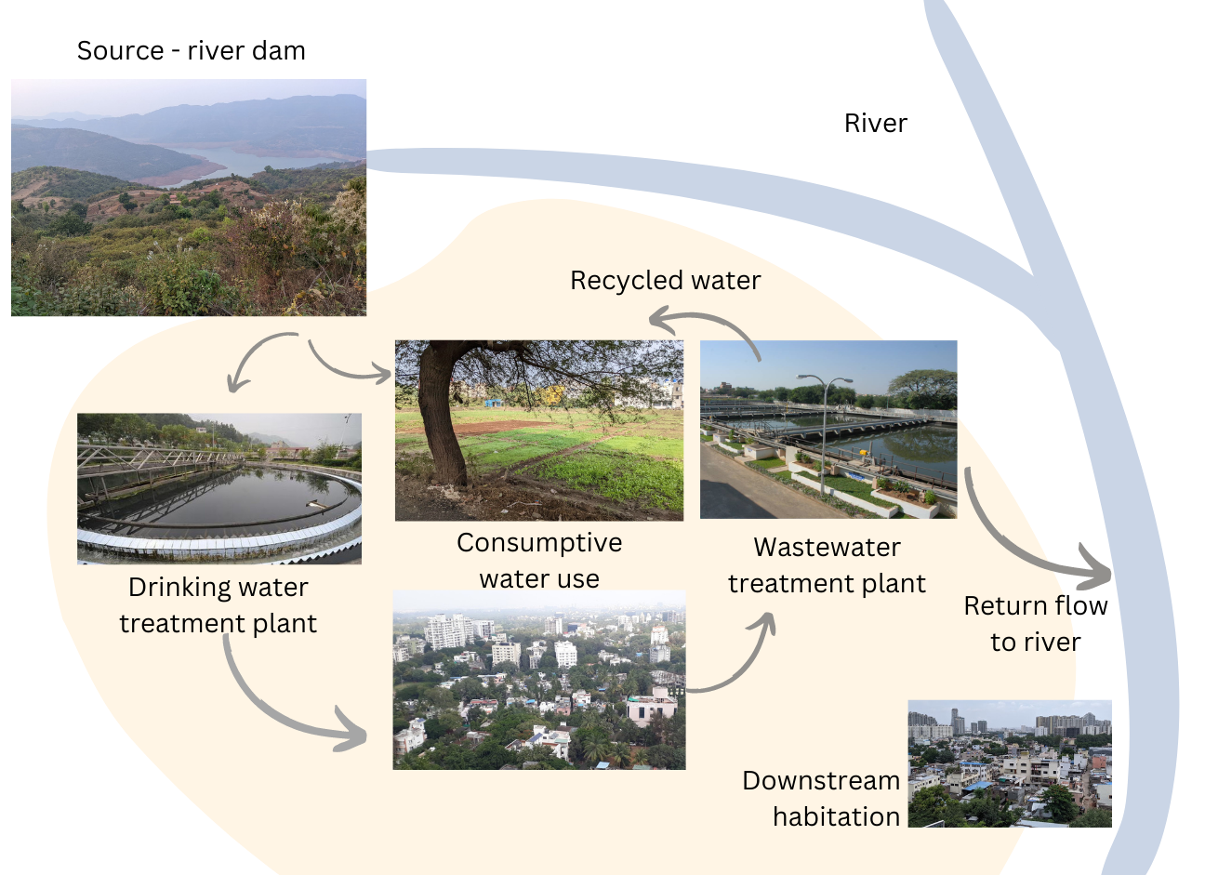
Water use and return flow
WATER CLASSROOMS
Reimagining Learning on Water
https://waterclassrooms.in/
Image credits
Drinking water treatment plant: Google and Mohit Patil
Wastewater treatment plant: Pune Municipal Corporation
All others: Sanskriti Menon

Slide 6
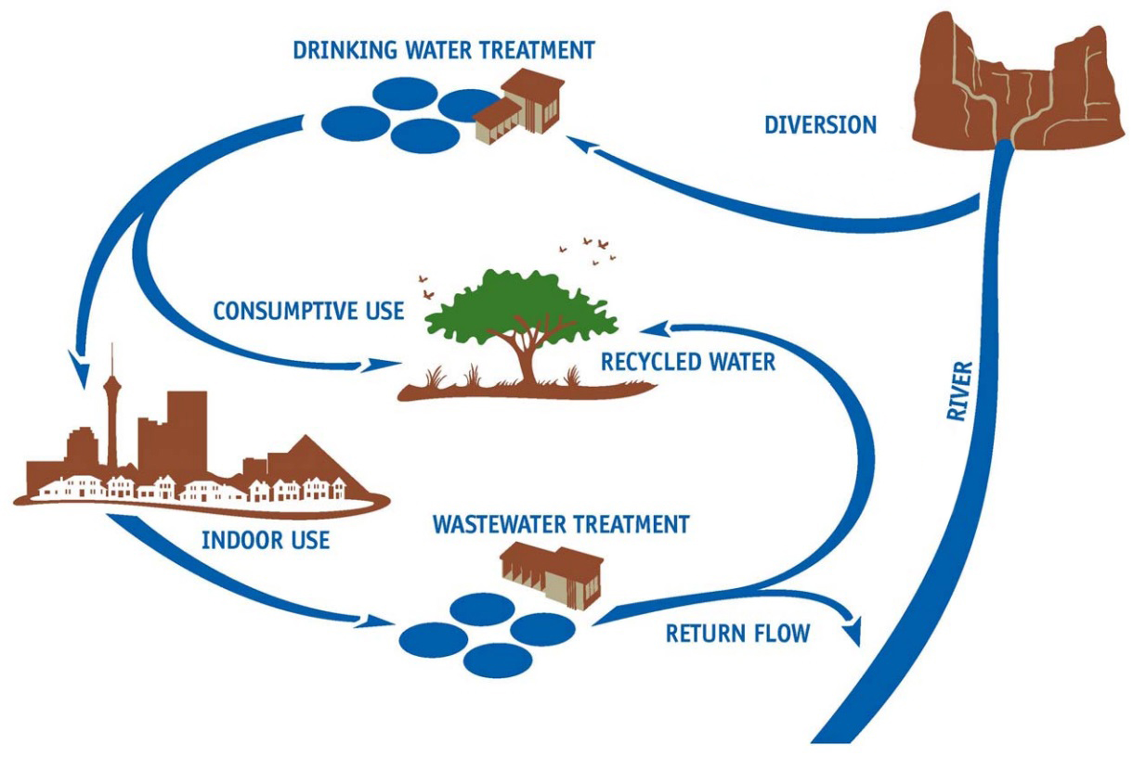

Where does wastewater go?
https://waterknowledge.colostate.edu/water-management-administration/water-uses/

Slide 7
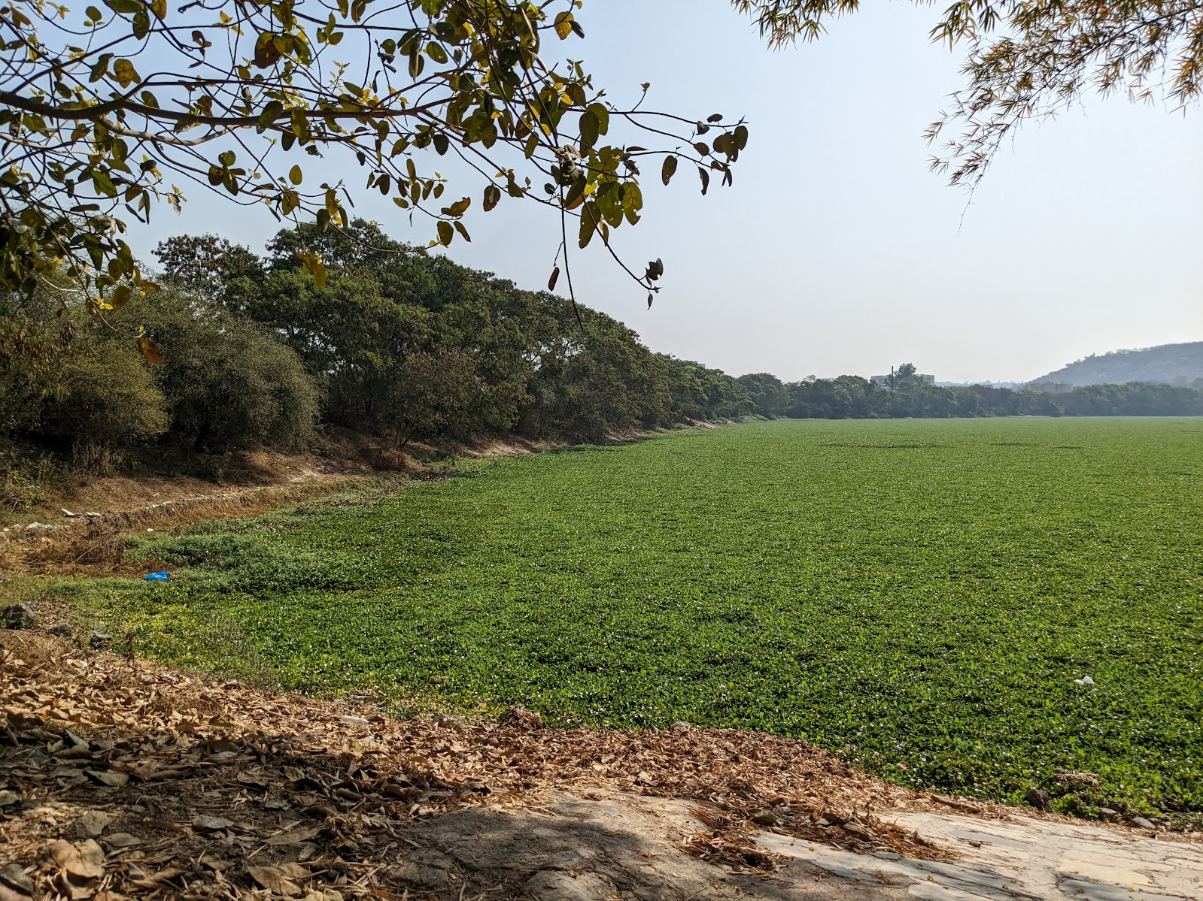
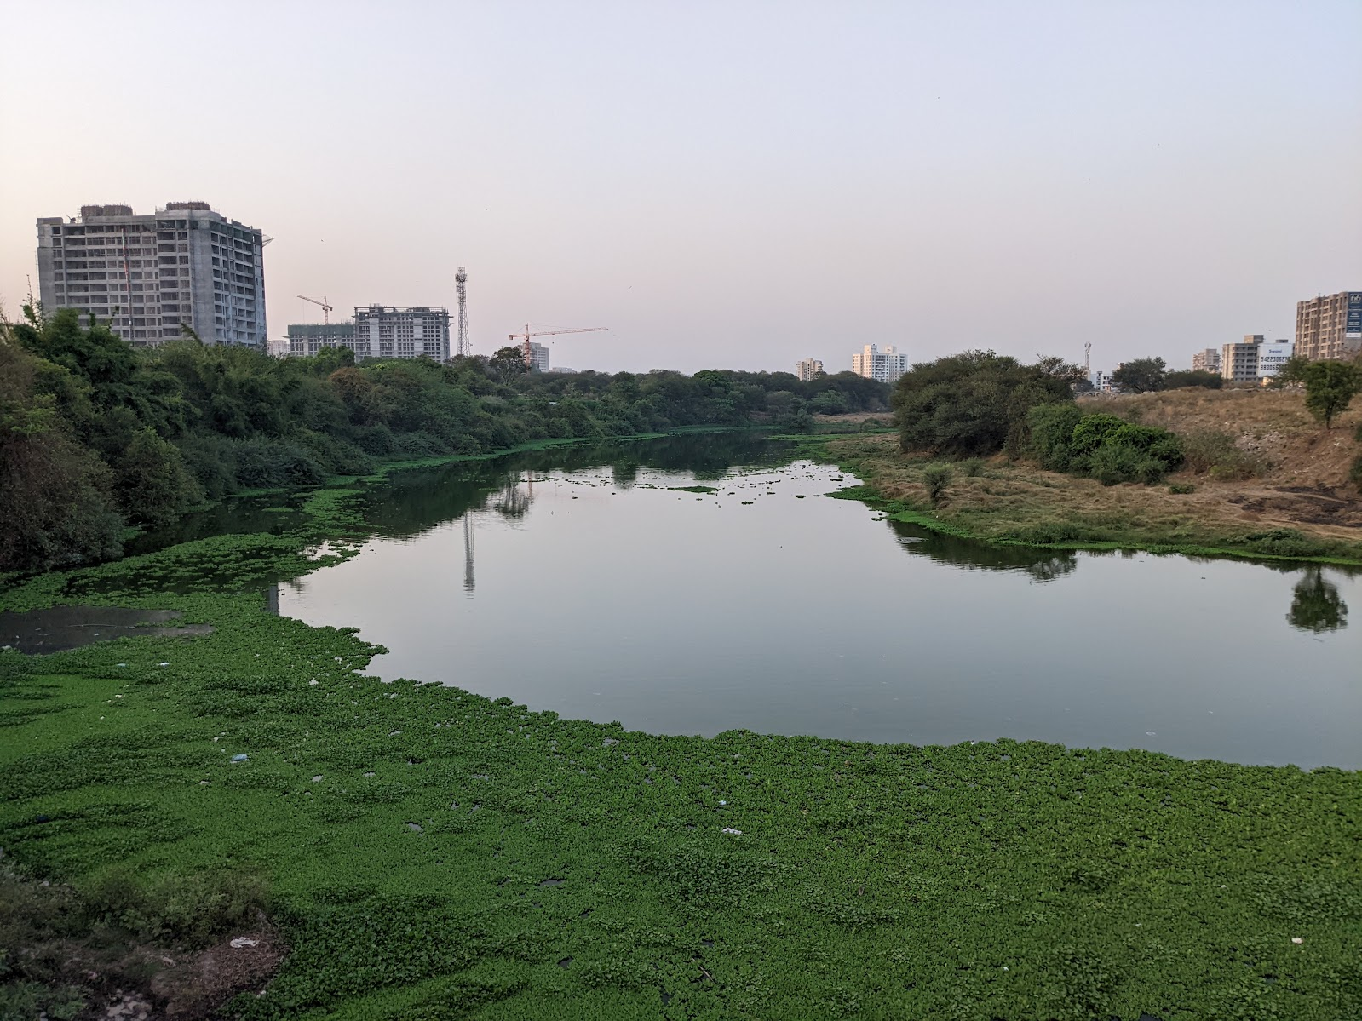
What happens if wastewater is not treated?
Untreated sewage often causes rapid growth of water hyacinth, an invasive plant, which cover the water surface, reduces oxygen in the water, and prevents other native species to thrive. Mosquitoes however find it a great habitat. Studies show that hyacinth can be used for sewage treatment with proper management.
Sanskriti Menon
Sanskriti Menon
Hyacinth in Pashan Lake and the Mula River

Slide 8
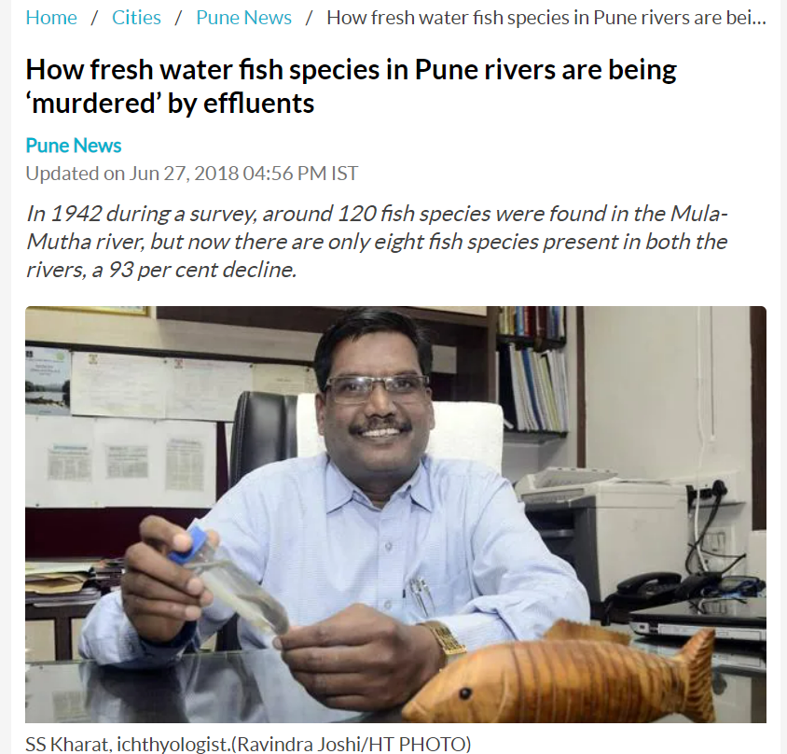
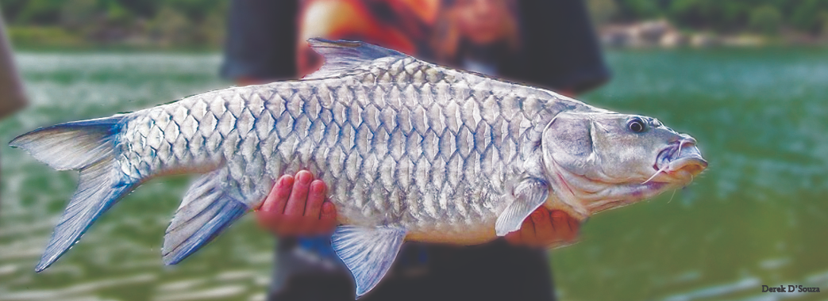
Derek D’Souza
https://wasiindia.com/the-mahseer/
How fresh water fish species in Pune rivers are being ‘murdered’ by effluents - Hindustan Times

Slide 9

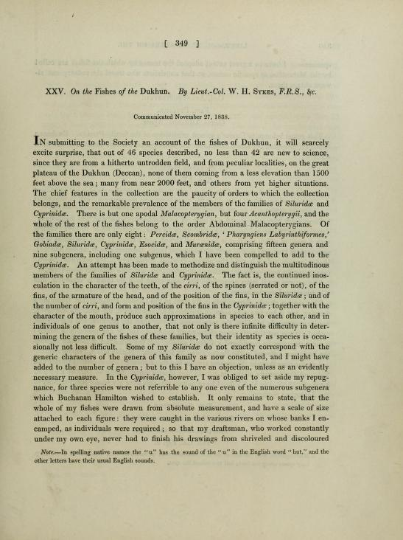
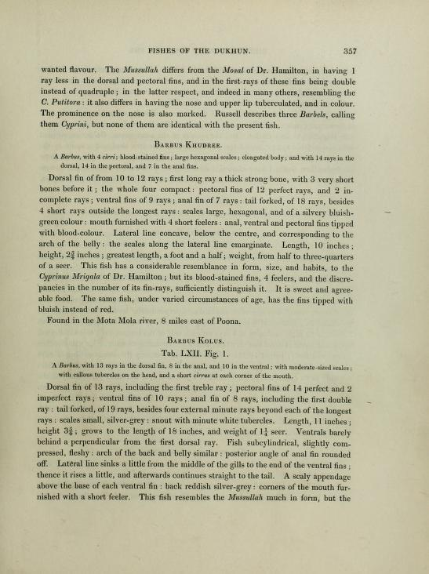
On the Fishes of the Dukhun
By Lieut Col W H Sykes, FRS & C
From
Biodiversity Heritage Library
Contributed by the Natural History Museum Library, London

Slide 10
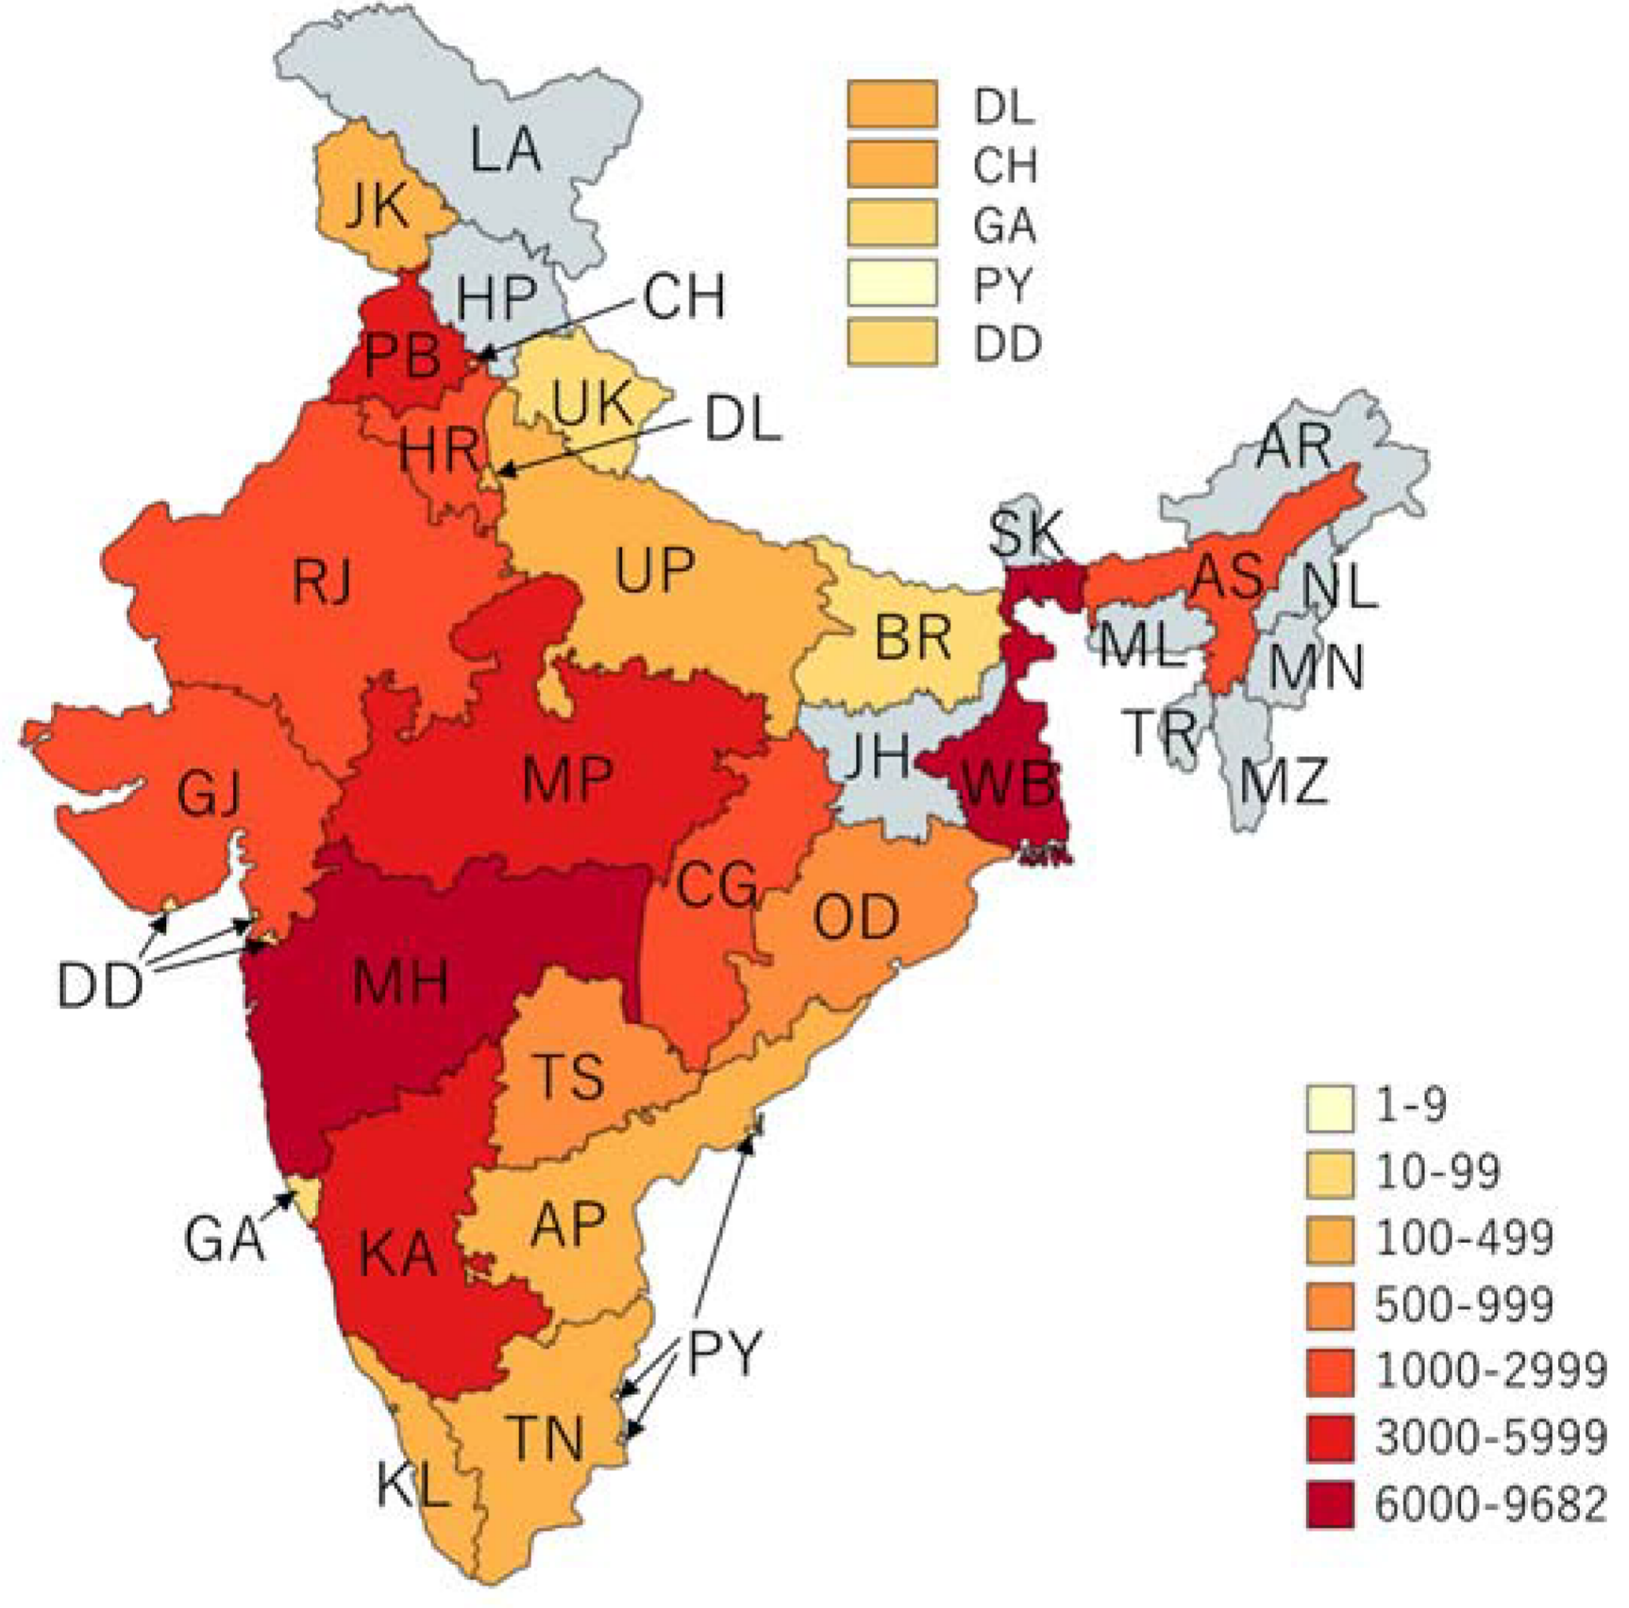
Cholera Outbreaks in India
2011-2020
Some water-borne diseases that may spread due to untreated sewage
Cholera
Dysentery
Typhoid
Hepatitis A
Pune: Water Borne Epidemics In Khadakwasla Dam Chain, Bacteria Has Increased 150 Times In 15 Years
Cholera outbreaks (n = 565) by state and union territories, India, 2011–2020
Muzembo, Basilua Andre et al (May 2022) Cholera Outbreaks in India, 2011–2020: A Systematic Review

Slide 11
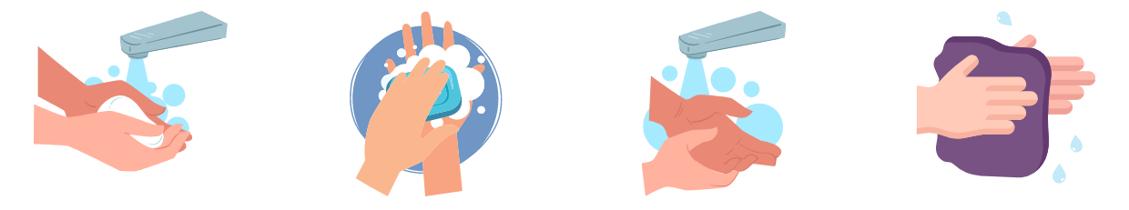
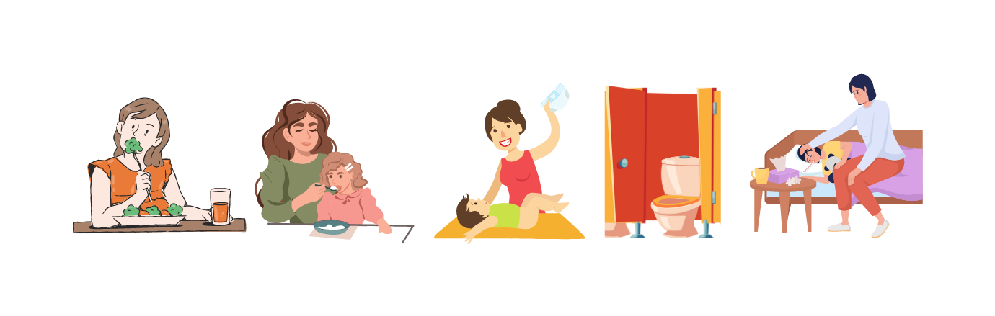
Wash your hands
Wet your hands with treated water
Use soap, lather well, clean under your nails
Rinse well with treated water
Dry your hands with a clean kerchief, or air dry
WASH BEFORE
WASH AFTER
Eating
Feeding someone
Cleaning a baby
Going to toilet
Taking care of an ill person

Slide 12
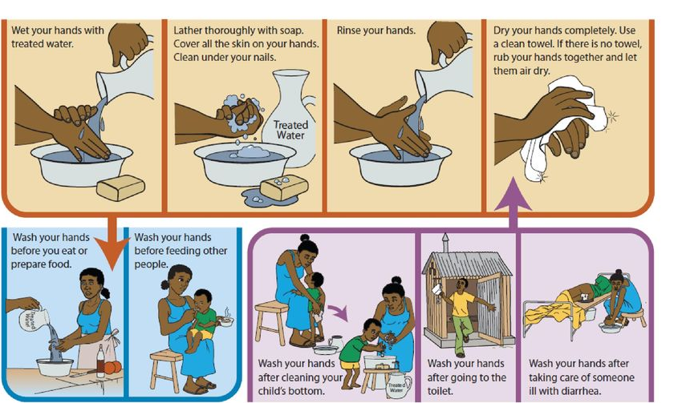
Can add handkerchief also as towel people may not carry out door

Slide 13
How to treat wastewater to make it safe?

Slide 14
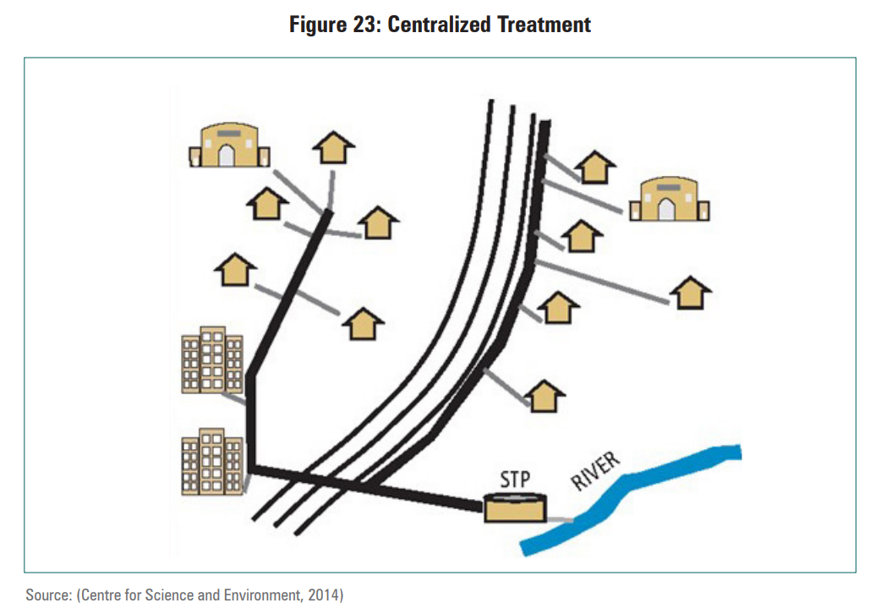
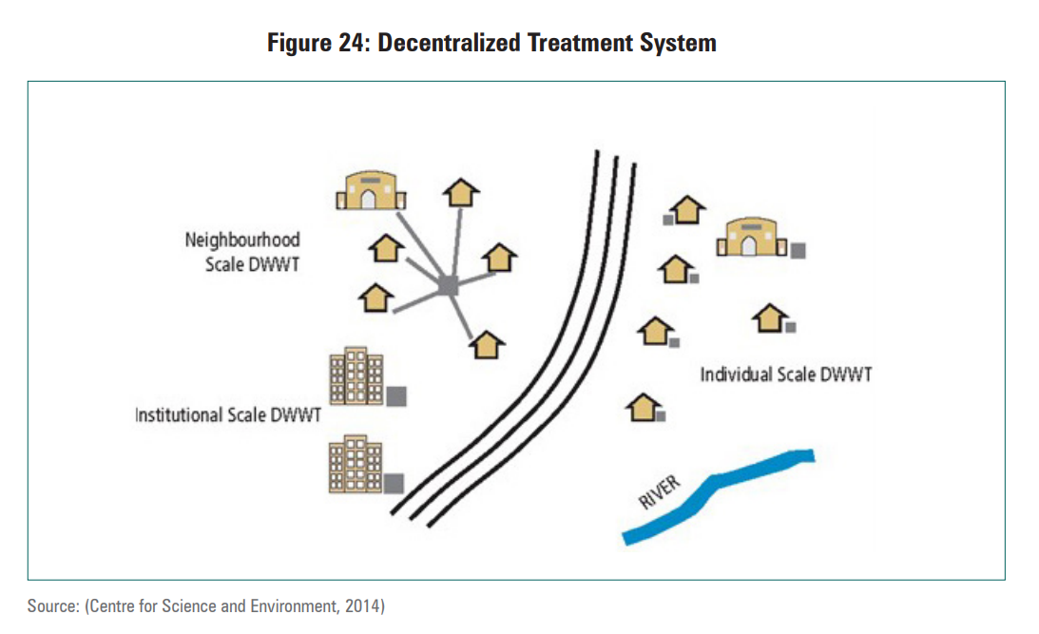
Centralized and Decentralized Wastewater Treatment
Source: Centre for Science and Environment, 2014

Slide 15
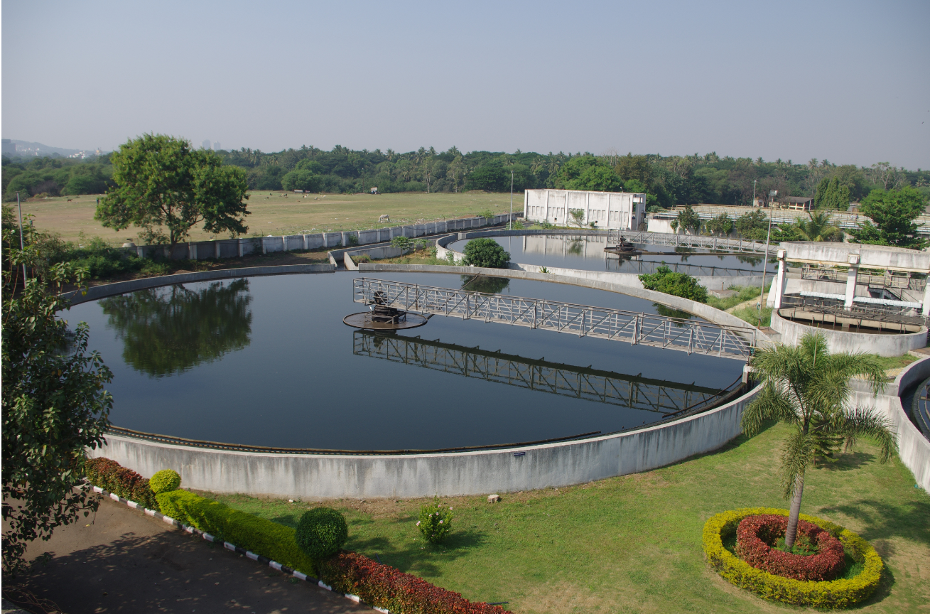
Centralized sewage treatment
Sewage treat plant, PMC
From PMC website https://www.pmc.gov.in/en/image-gallery/album-images/377

Slide 16
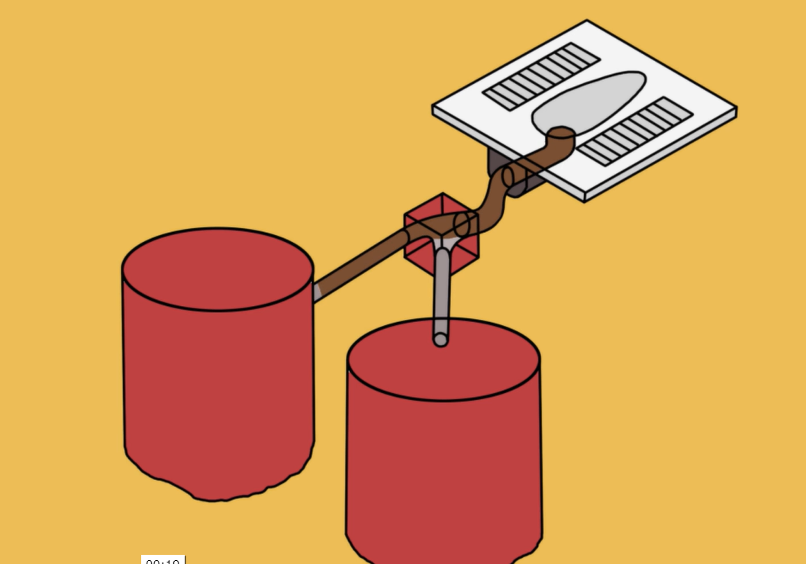
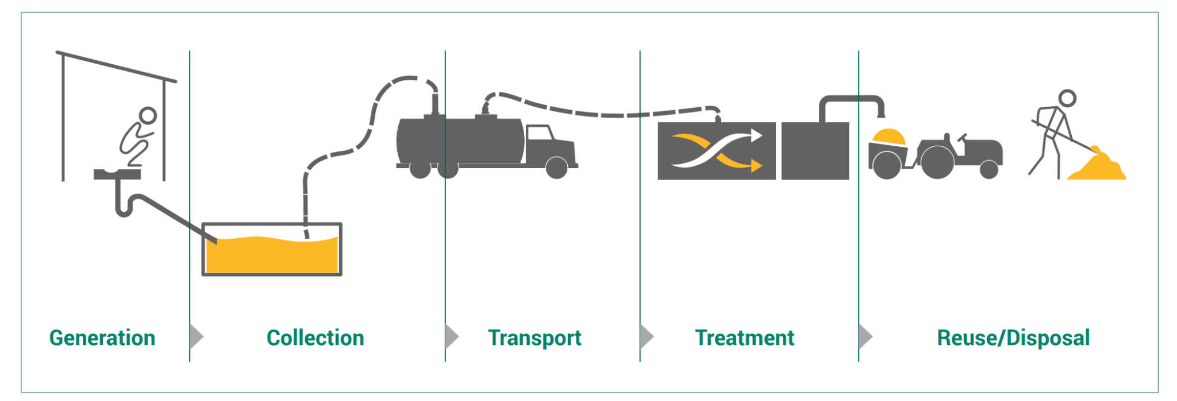
Decentralized sewage treatment
Soak pit
Soak pit image from
Anusha Menon, 2016. Video. Public Service Announcement - Build your own toilet
https://vimeo.com/157816988
Septic Tank + offsite treatment
NIUA (2018) “Faecal Sludge and Septage Management: An Orientation Module”.
https://www.susana.org/_resources/documents/default/3-3221-153-1526713358.pdf

Slide 17
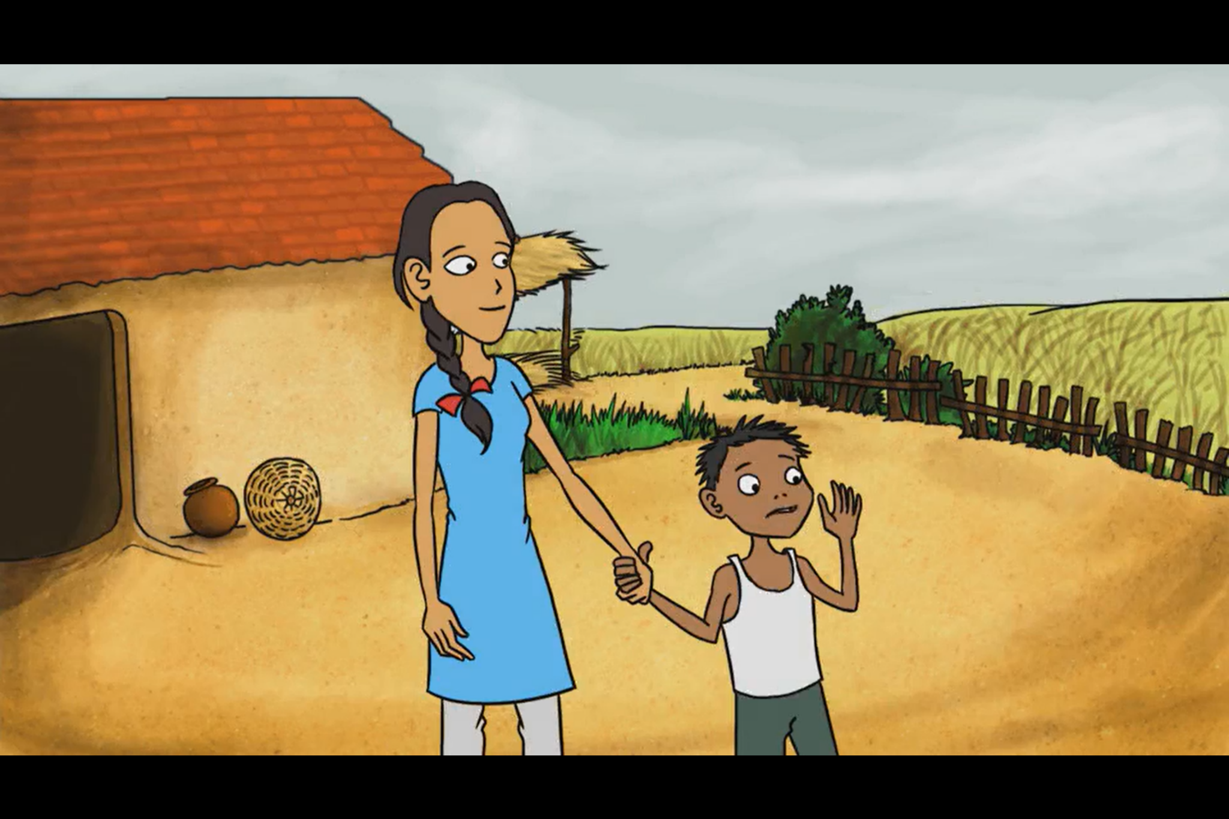
https://vimeo.com/157816988
Watch this video on constructing a soak pit.

Slide 18
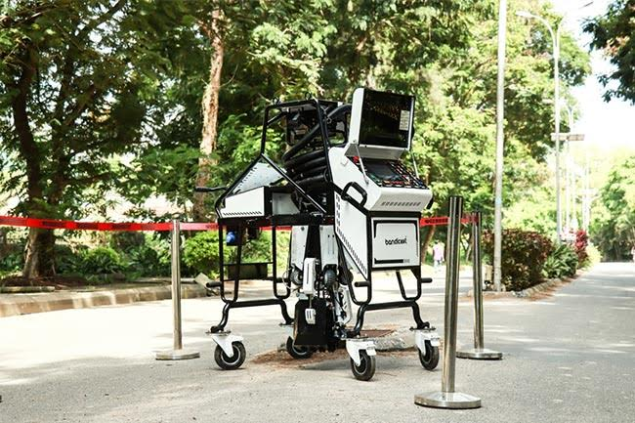
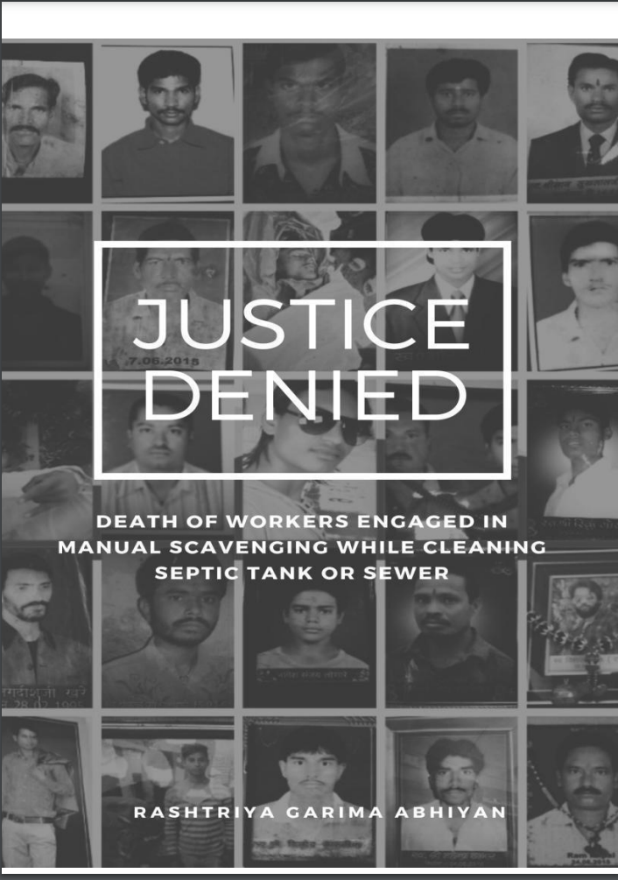
LOCALISING SDG'S NEWS
PMC launches robots to replace manual scavenging for sewer cleaning
MAY 4, 2022 by TEAM URBAN UPDATE
Representative Image
PUNE, Maharashtra: The Pune Municipal Corporation (PMC) has introduced three advanced robots to clean and maintain manholes in the city safely without having workers entering them. The initiative has been launched to bring more safety to the maintenance of city manholes. Vikram Kumar, Commissioner, PMC, launched the robots at PMC on May 2.
Manual Scavenging
Manual scavenging is the practice of removing human excreta by hand from sewers or septic tanks. The practice is banned in India under the Prohibition of Employment as Manual Scavengers and their Rehabilitation Act, 2013 (PEMSR).
Justice Denied, a 2018 report by Rashtriya Garima Abhiyan notes that the illegal practice continues.
https://urbanupdate.in/pmc-launches-robots-to-replace-manual-scavenging-for-sewer-cleaning/ . AIILSG (2022). Urban Update.

Slide 19
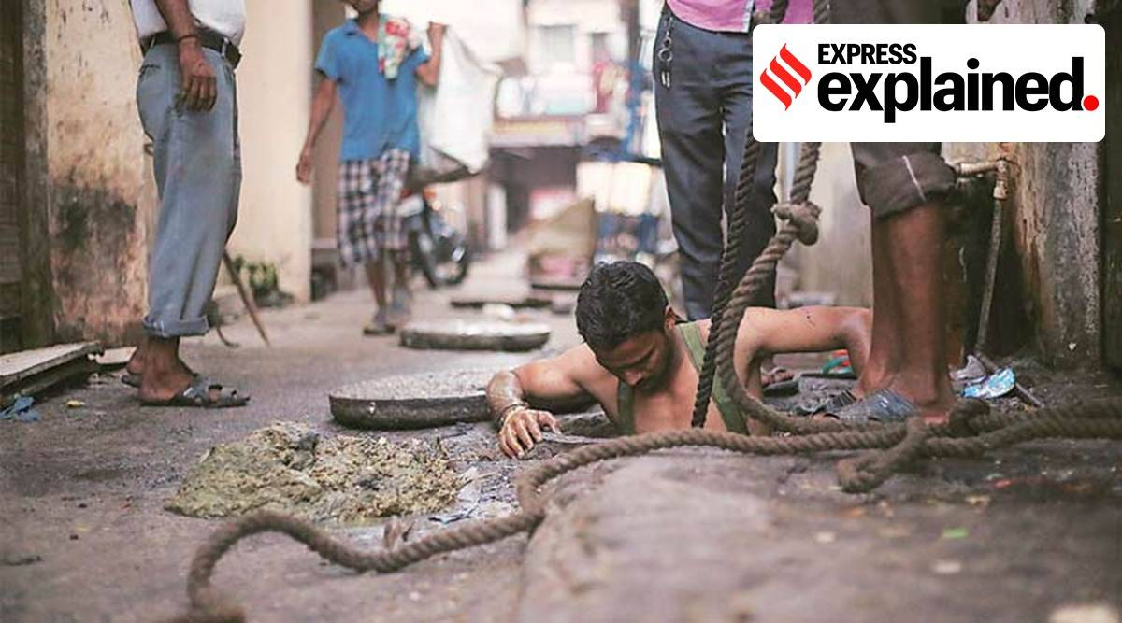
LOCALISING SDG'S NEWS
PMC launches robots to replace manual scavenging for sewer cleaning
MAY 4, 2022 by TEAM URBAN UPDATE
Representative Image
PUNE, Maharashtra: The Pune Municipal Corporation (PMC) has introduced three advanced robots to clean and maintain manholes in the city safely without having workers entering them. The initiative has been launched to bring more safety to the maintenance of city manholes. Vikram Kumar, Commissioner, PMC, launched the robots at PMC on May 2.
What is manual scavenging, and why is it still prevalent in India?
Three labourers in Mumbai, allegedly hired for manual scavenging, died on Thursday afternoon after inhaling toxic fumes in a septic tank. What is manual scavenging, and why is it still prevalent in India?
Manual scavenging is the practice of removing human excreta by hand from sewers or septic tanks. India banned the practice under the Prohibition of Employment as Manual Scavengers and their Rehabilitation Act, 2013 (PEMSR).
(Representative image)
https://indianexpress.com/article/explained/explained-what-is-manual-scavenging-and-why-is-it-still-prevalent-in-india-7815400/
https://urbanupdate.in/pmc-launches-robots-to-replace-manual-scavenging-for-sewer-cleaning/ . AIILSG (2022). Urban Update.

Slide 20
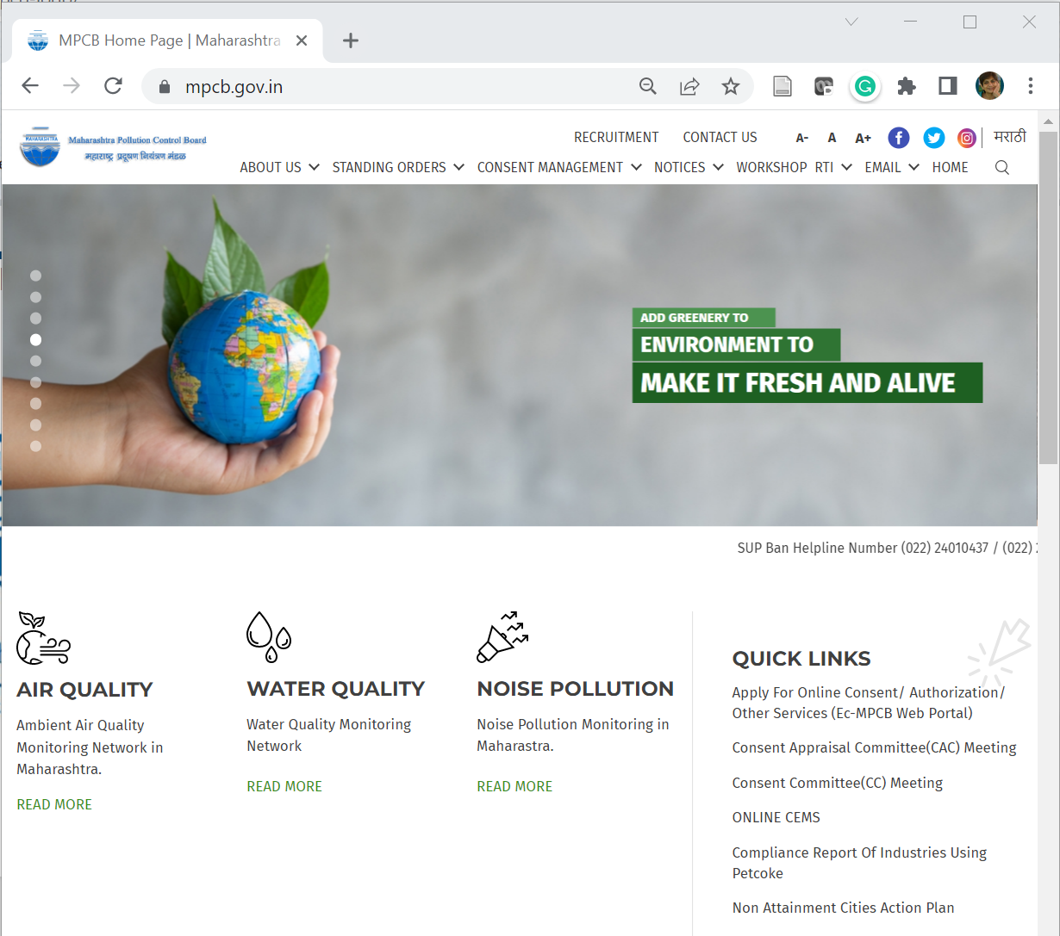
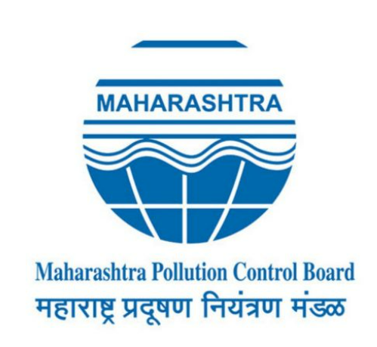
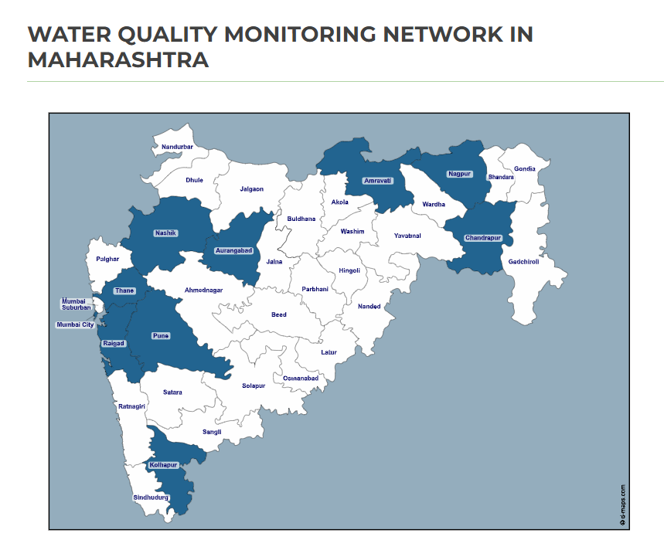
Is there a law for wastewater & water quality management?
Water (Prevention and Control of Pollution) Act, 1974 regulates pollution discharges and restore water quality of our aquatic resources
MPCB Website

Slide 21

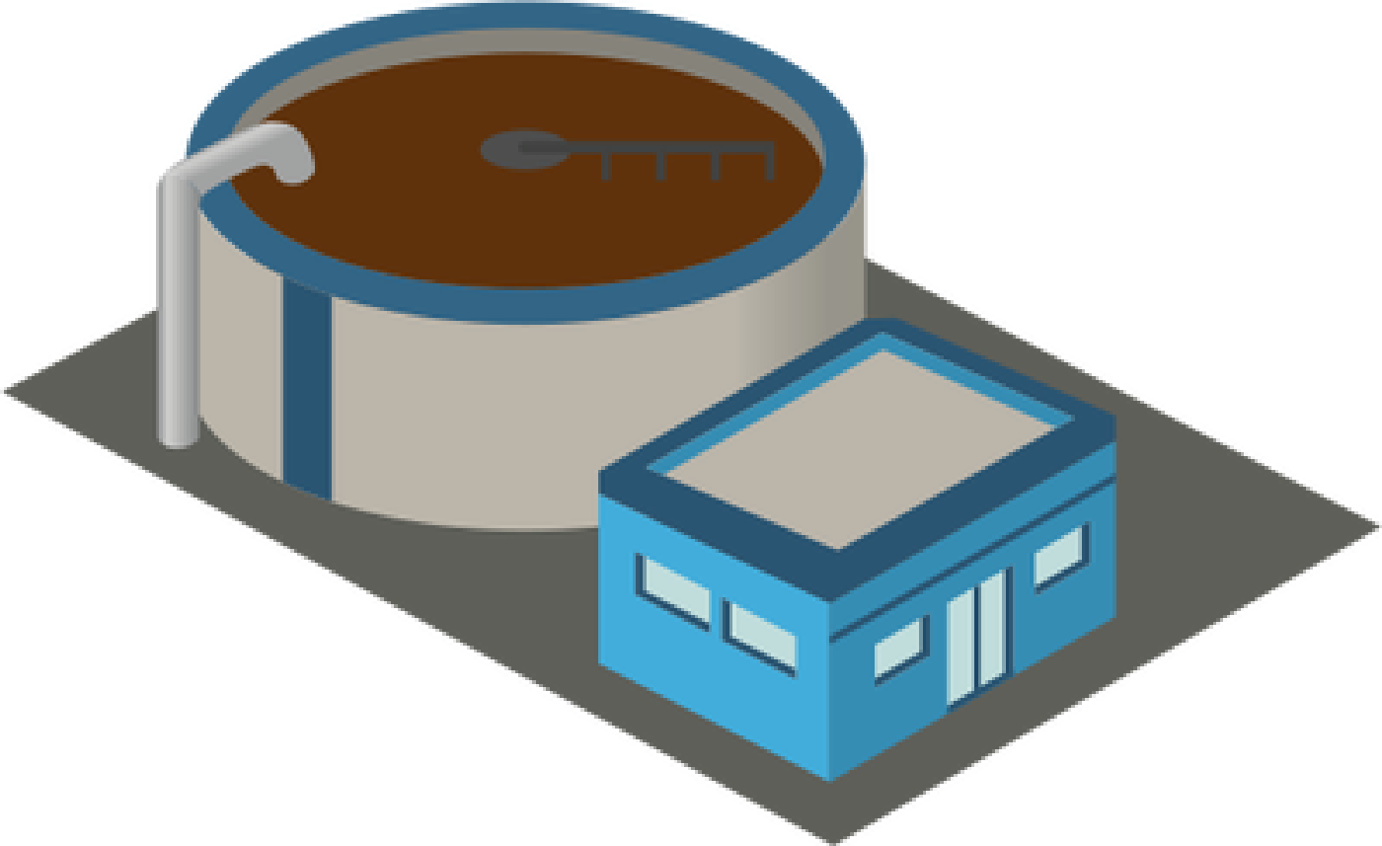
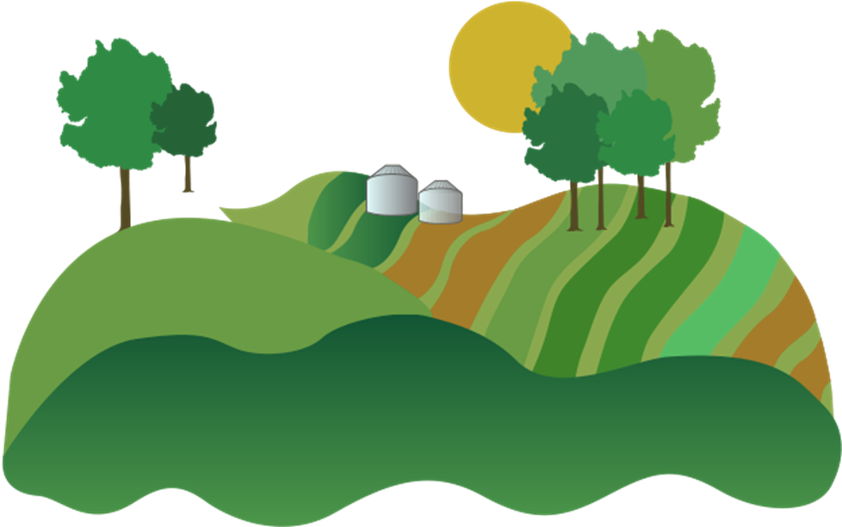
Is Wastewater a Resource?
Treated Water
Fertilizer
Nitrogen, Phosphorus, Potassium [NPK]

Slide 22
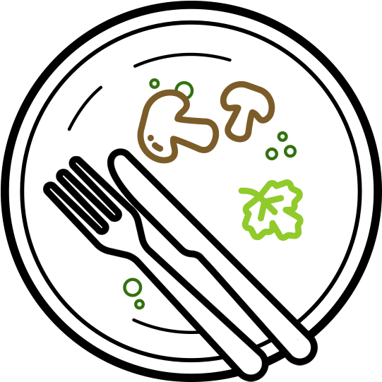

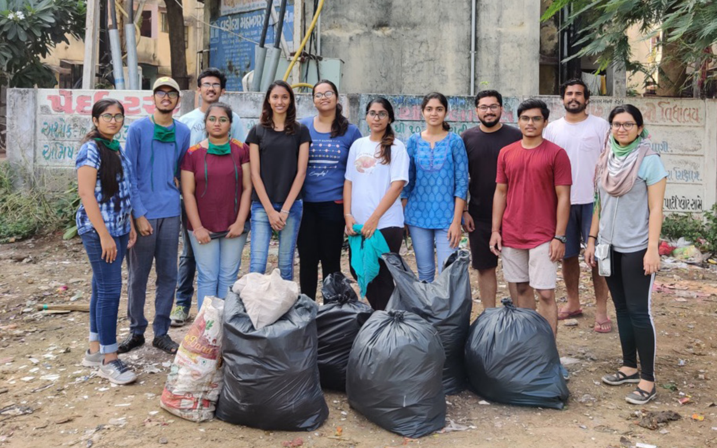
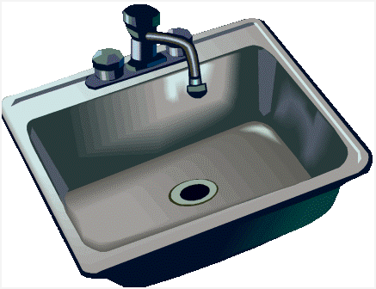


What can you do to reduce pollution due to wastewater?
CEE
Don’t throw food waste in the sink, you can compost it
Segregate waste, don’t litter, organize a clean-up to avoid waterbody pollution
Write a letter to the authorities with your observations if you see wastewater pollution

